Slide 1
Chapter 8: Cartography and Geovisualization

Slide 2
Learning outcomes
construct effective data graphics for presenting static, non-spatial data;
understand, design, and critique maps used for presenting spatial data; and
apply the principles of interaction design to GIS interfaces that go beyond presentation of spatial data to help in analysis, exploration, and decision-making with geographic information.

Slide 3
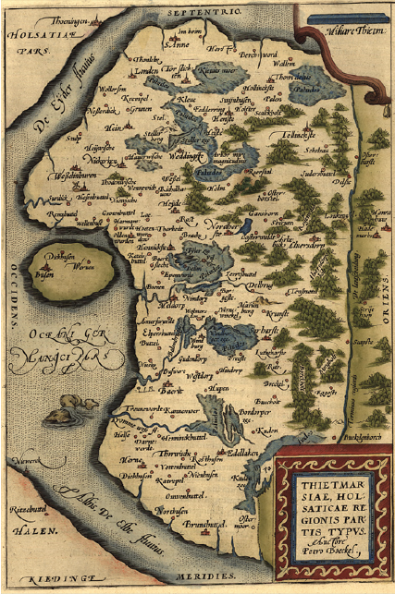
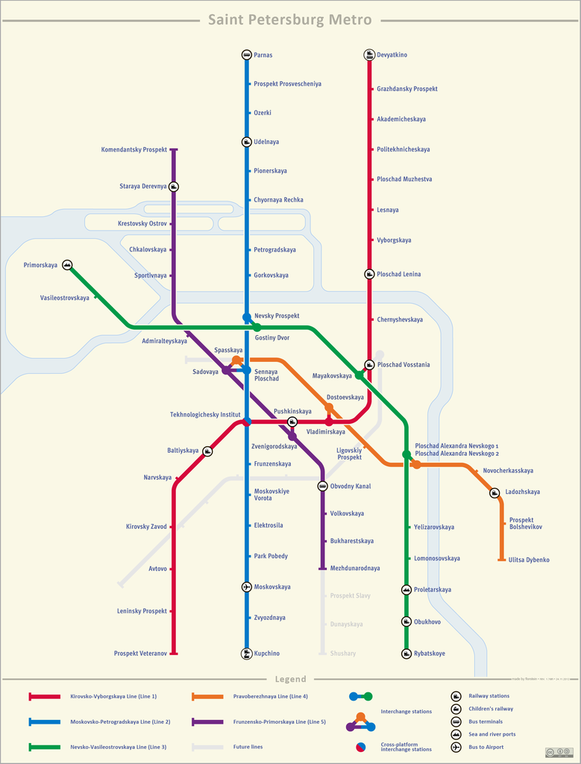
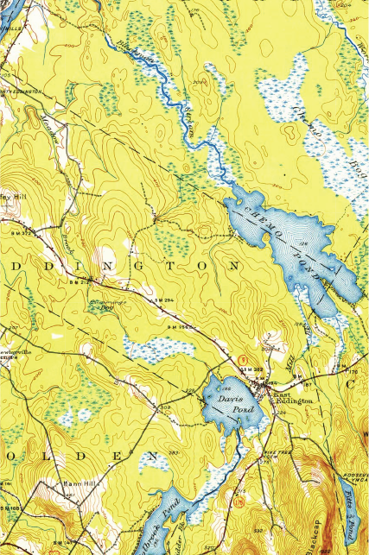
What is your favourite map?
1944 1:62500 topographic map (Source: U.S. Geological Survey)
St Petersburg subway map (Copyright Alex Florstein)
Ortelius' 1570 Thietmarsia map (Source: U.S. Library of Congress)

Slide 4
Section 8.1
Data graphics

Slide 5
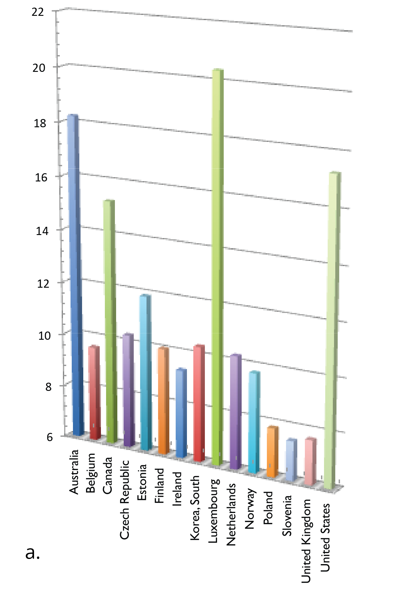
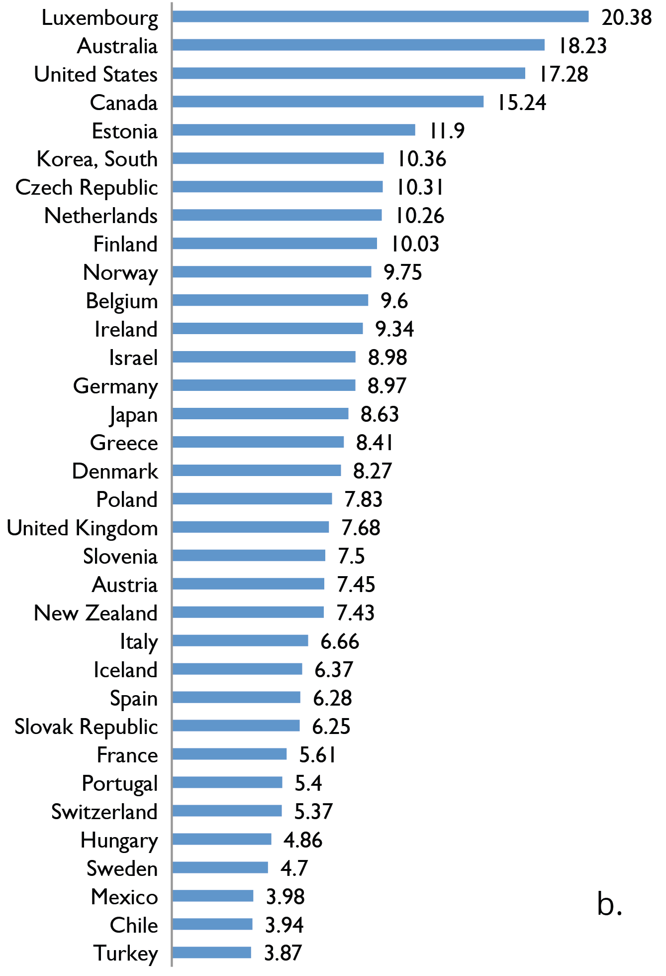
Which is better? Which is preferable?

Slide 6
Four principles of data graphics (Tufte)
Data density: presenting as much data as possible in the space available
Data integrity: presenting the data itself, as far as possible, and avoiding embedding misleading messages in the data graphic.
Correspondence: helping the viewer to understand patterns and form hypotheses about the relationships in the data
Aesthetics: “simplicity of design and complexity of data”

Slide 7
Data density
Lower
Higher

Slide 8
Data integrity
Lower
Higher

Slide 9
Correspondence
Lower
Higher

Slide 10
Aesthetics
Lower
Higher

Slide 11
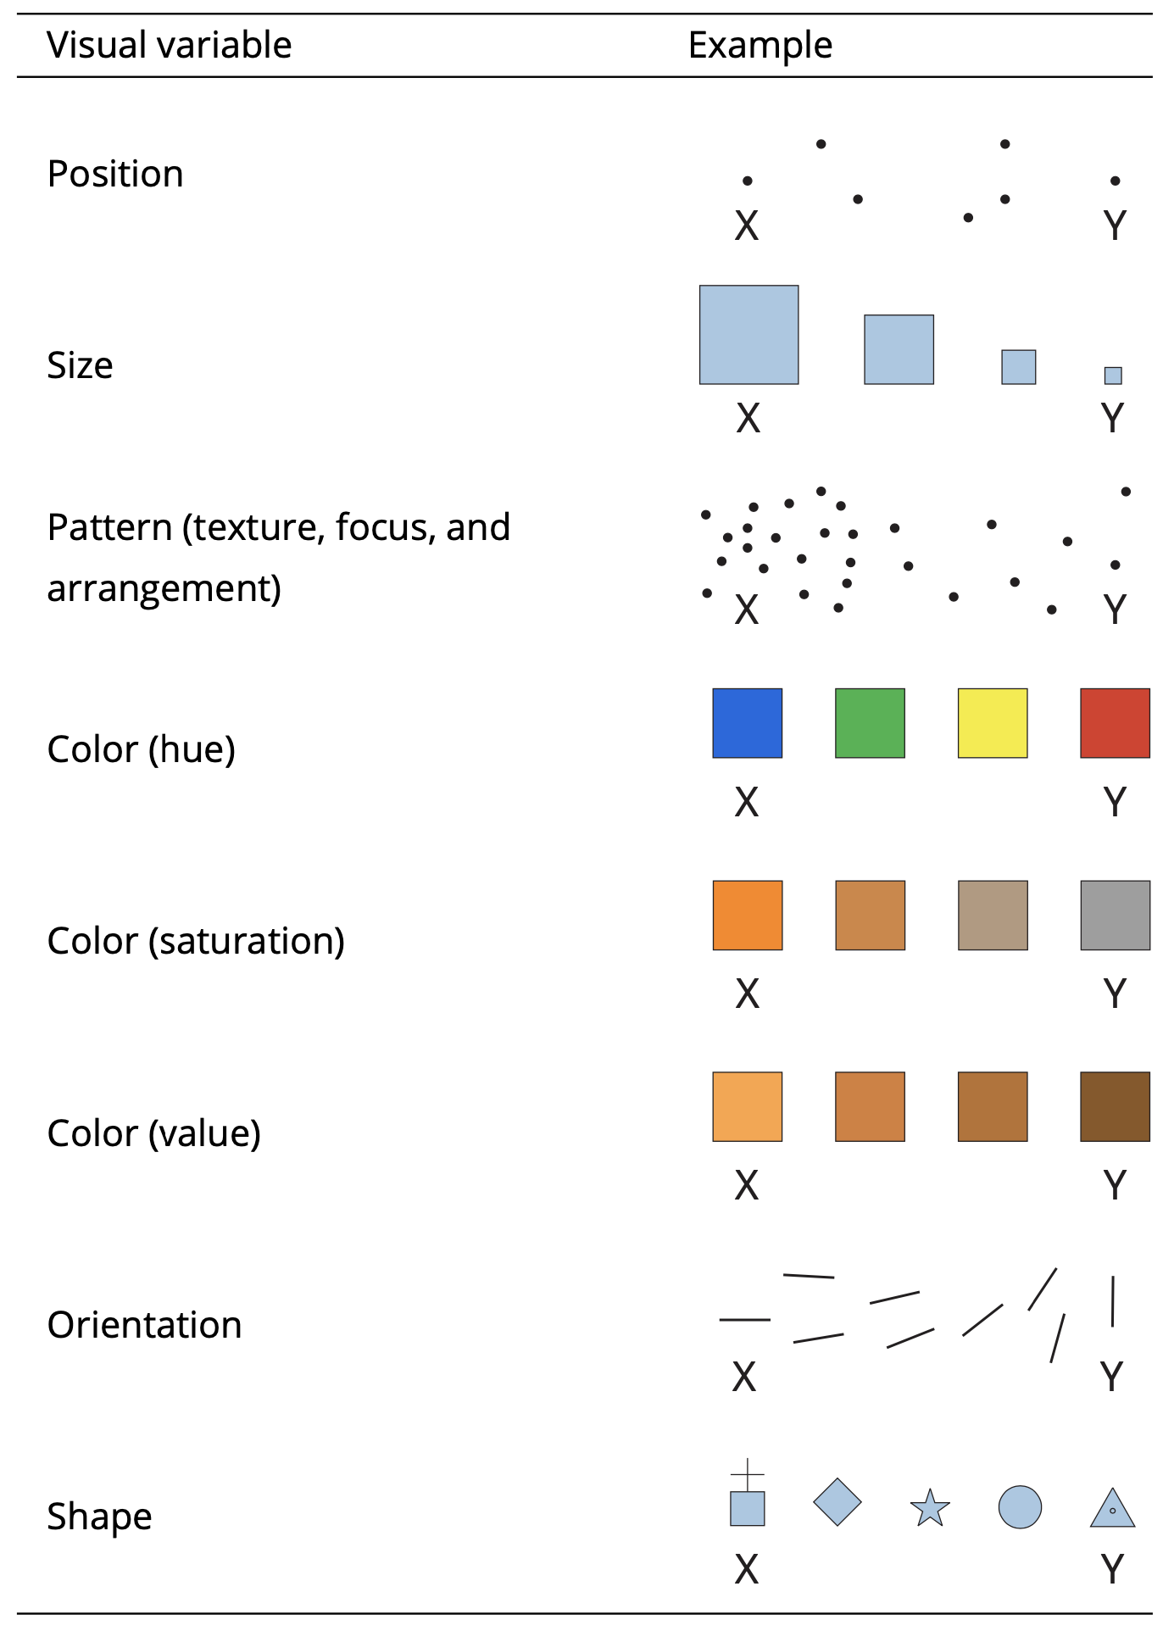
Visual variables
All data graphics (including maps) are constructed from basic visual symbols, called marks
The different ways in which the characteristics of marks can be varied are termed visual variables or graphic variables
Position: relative and absolute
Pattern: texture (density) and arrangement (e.g., ordered or random)
Color (HSV):
hue, refers to the shade of a color
value refers to the brightness of a color
saturation refers to the purity of a color
Shape: abstract or mimetic
Size and Orientation

Slide 12
Visual variables: Position, size, pattern

Slide 13
Visual variables: Color (HSV)

Slide 14
Visual variables: Orientation and shape

Slide 15
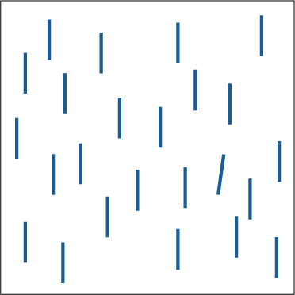
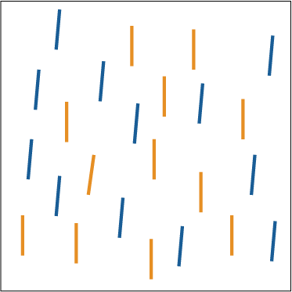
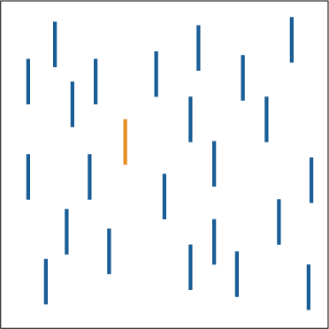
Preattentive Features
Human perception is able to spot some differences (including line orientation, length, width, size, curvature, number, color hue, … and many more) even without conscious thought: “pop-out”

Slide 16
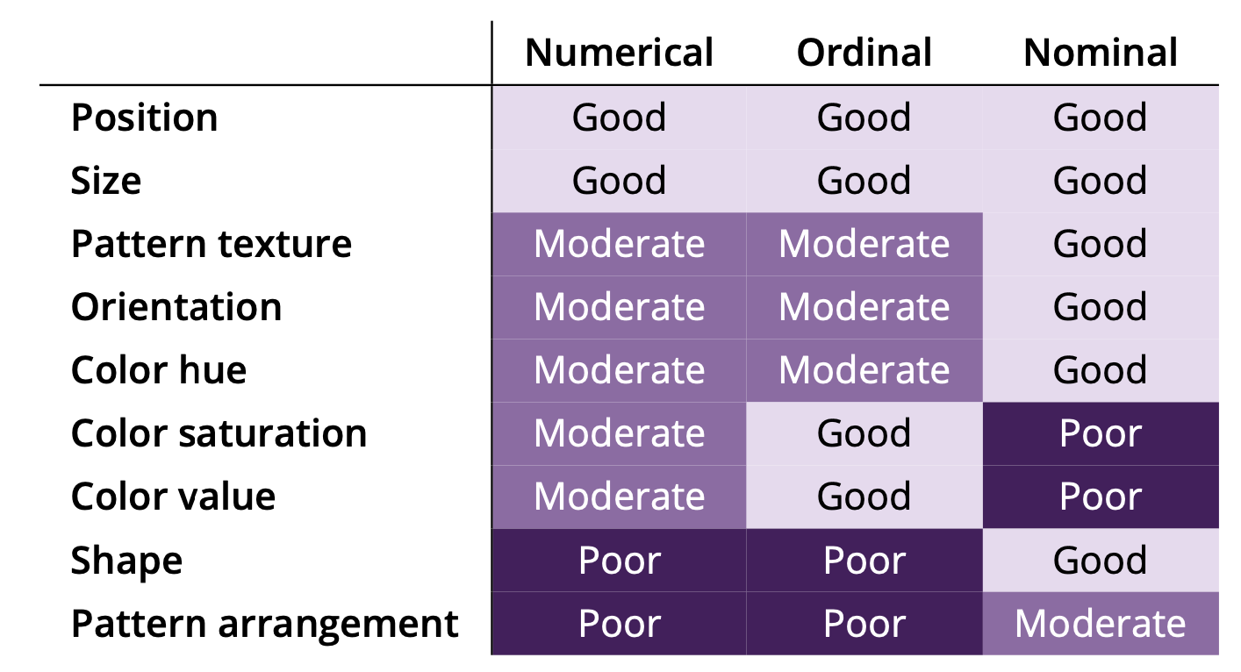
Value message
Certain visual variables can allow more than simple difference to be depicted; they may also allow relative values to be communicated.

Slide 17
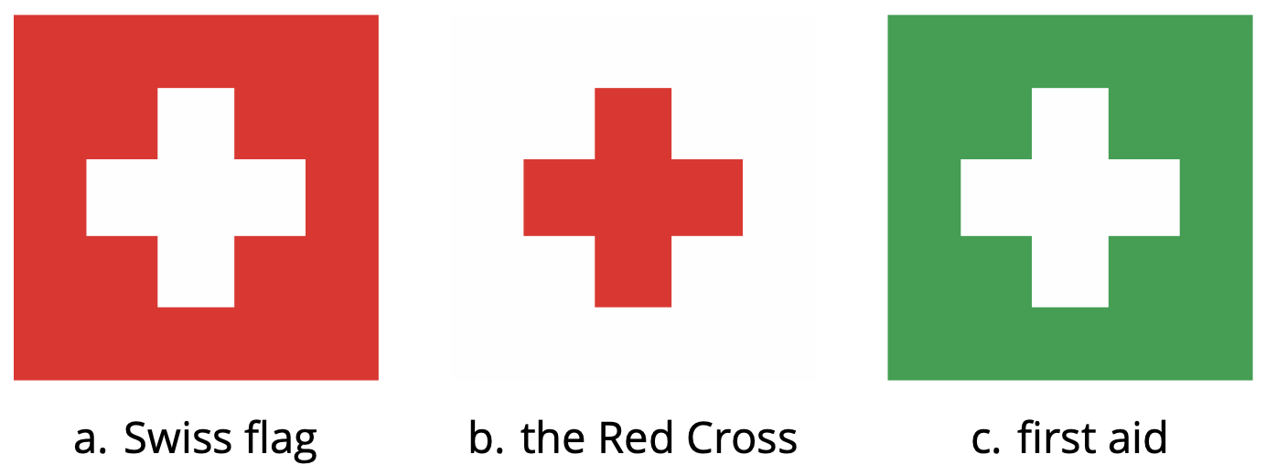
Semantics
Variations in each visual variable may trigger common associations or messages

Slide 18
Section 8.2
Cartography

Slide 19
Cartography
The art, science, technology, and history of maps and map-making
Maps are amongst the highest data densities of any type of data graphic.
An important distinction must be made between the spatial and graphical representation of objects.
Spatial objects exist to directly model the application domain
Graphical objects are the presentational form of spatial objects.
Traditional hardcopy maps conflate the data storage and data presentation functions of a GIS.

Slide 20
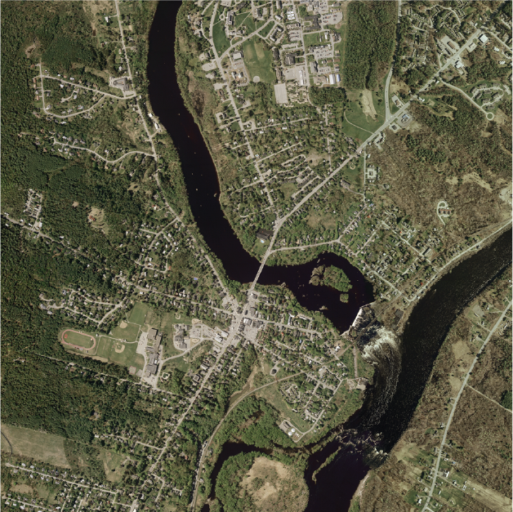
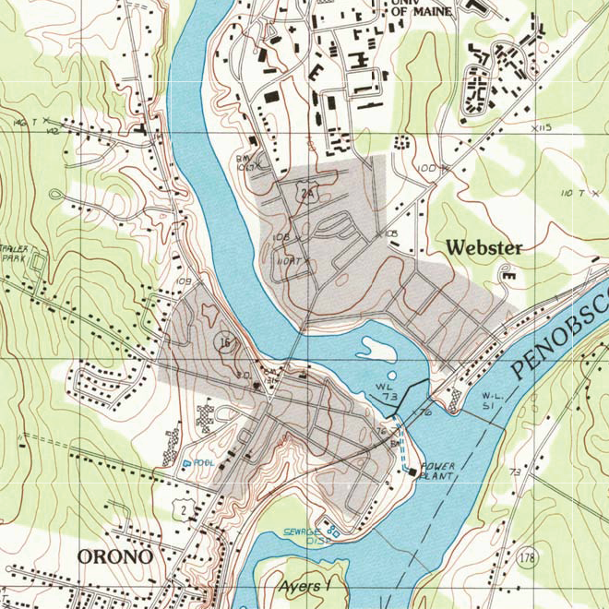
Abstraction
Maps are effective at presentation because they provide an abstract representation of the geographical world: allows users to focus on salient relationships not irrelevant details

Slide 21
Abstraction
The map achieves this abstract form by reducing the detail of both the semantic and geometric information it depicts.
Reduction in detail is achieved through:
Classification: selecting a small number of aggregate feature types to portray
Generalization: reduction in geometric detail

Slide 22
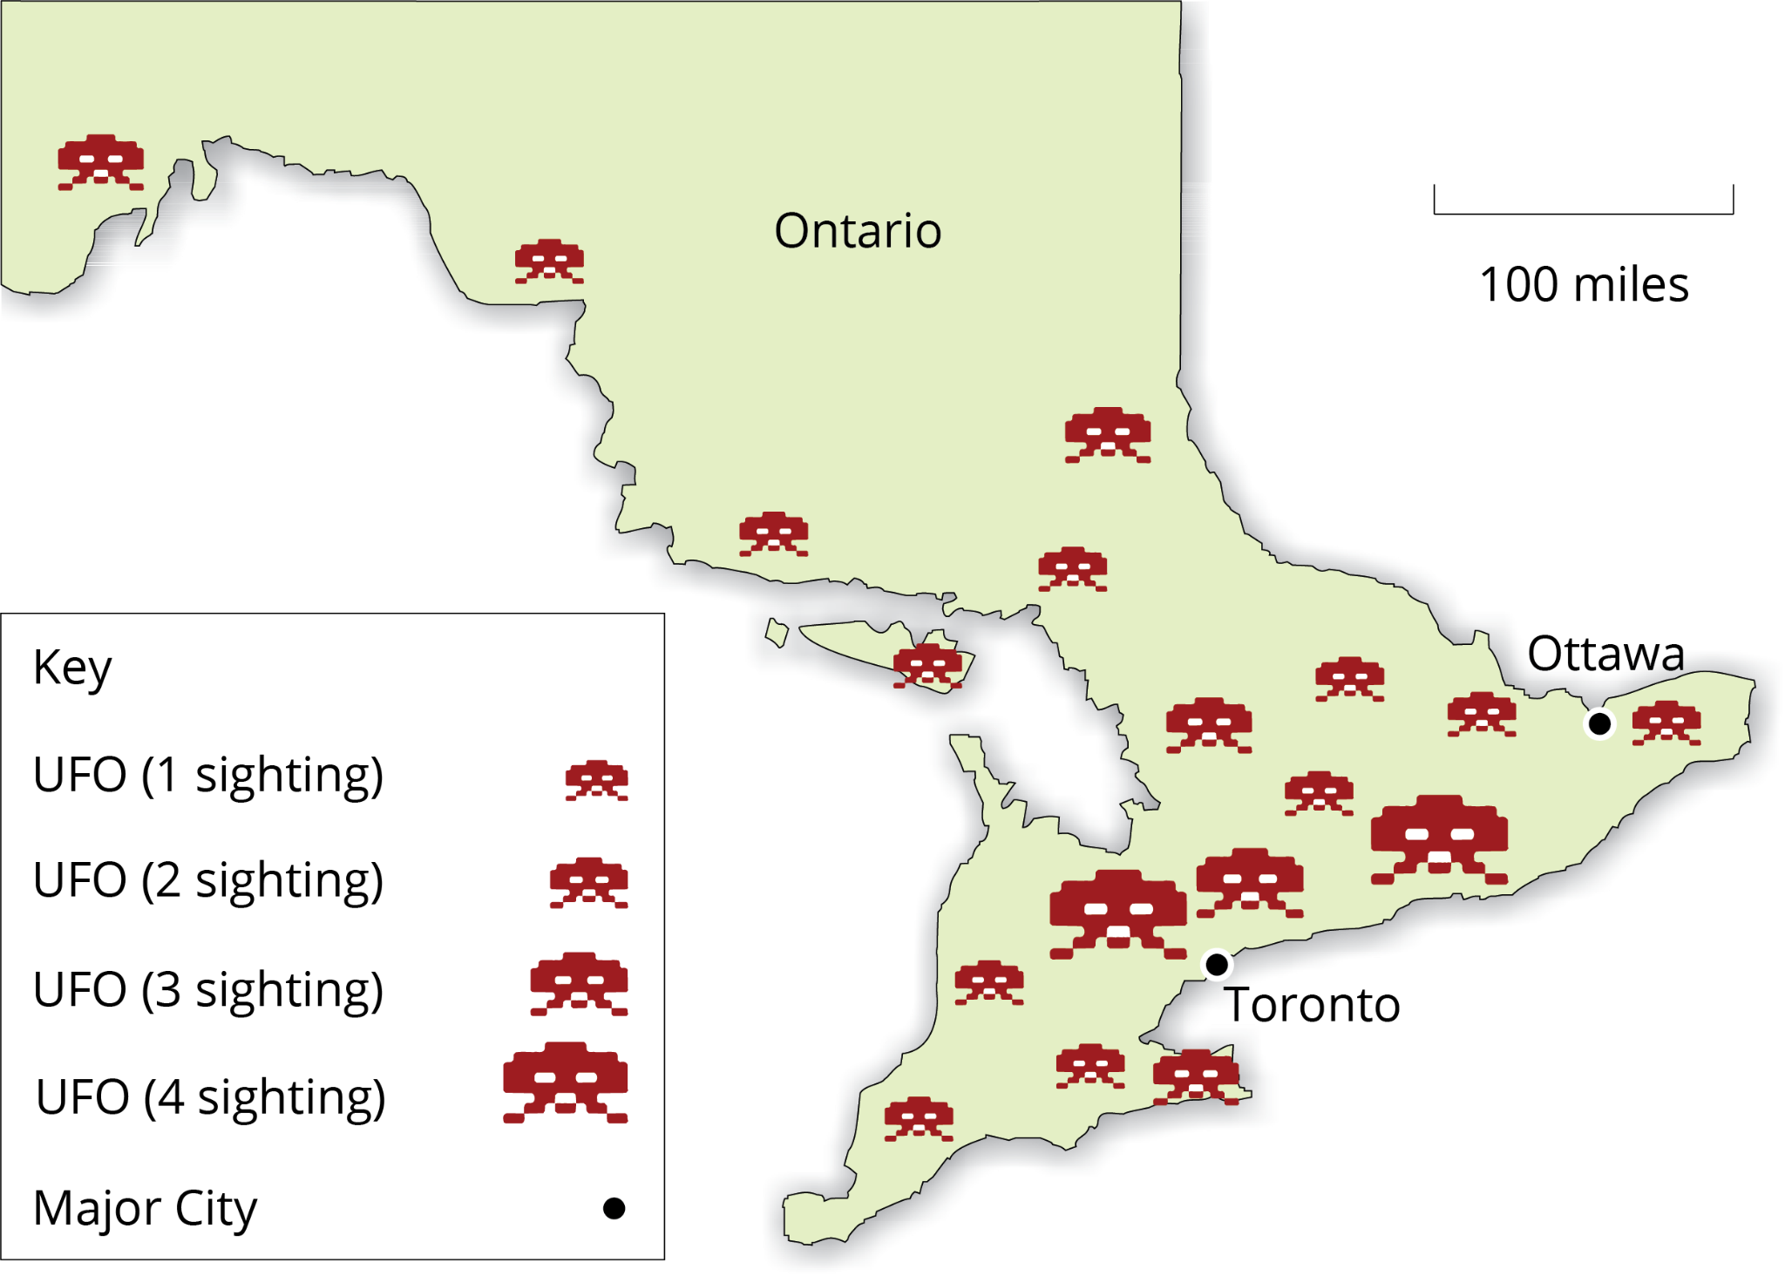
Thematic maps: Proportional symbol

Slide 23
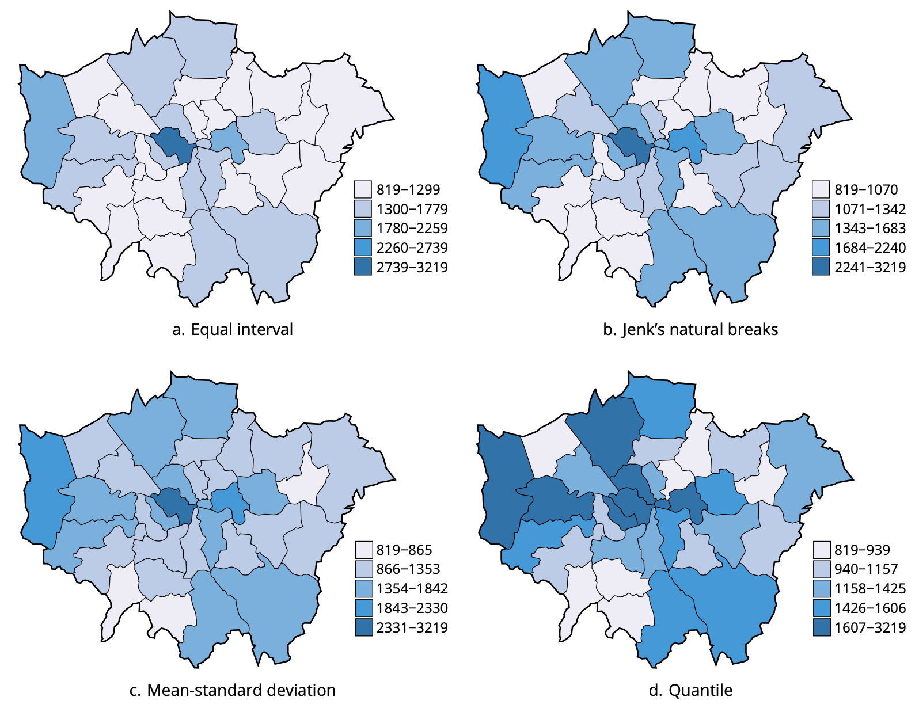
Thematic maps: Choropleth

Slide 24
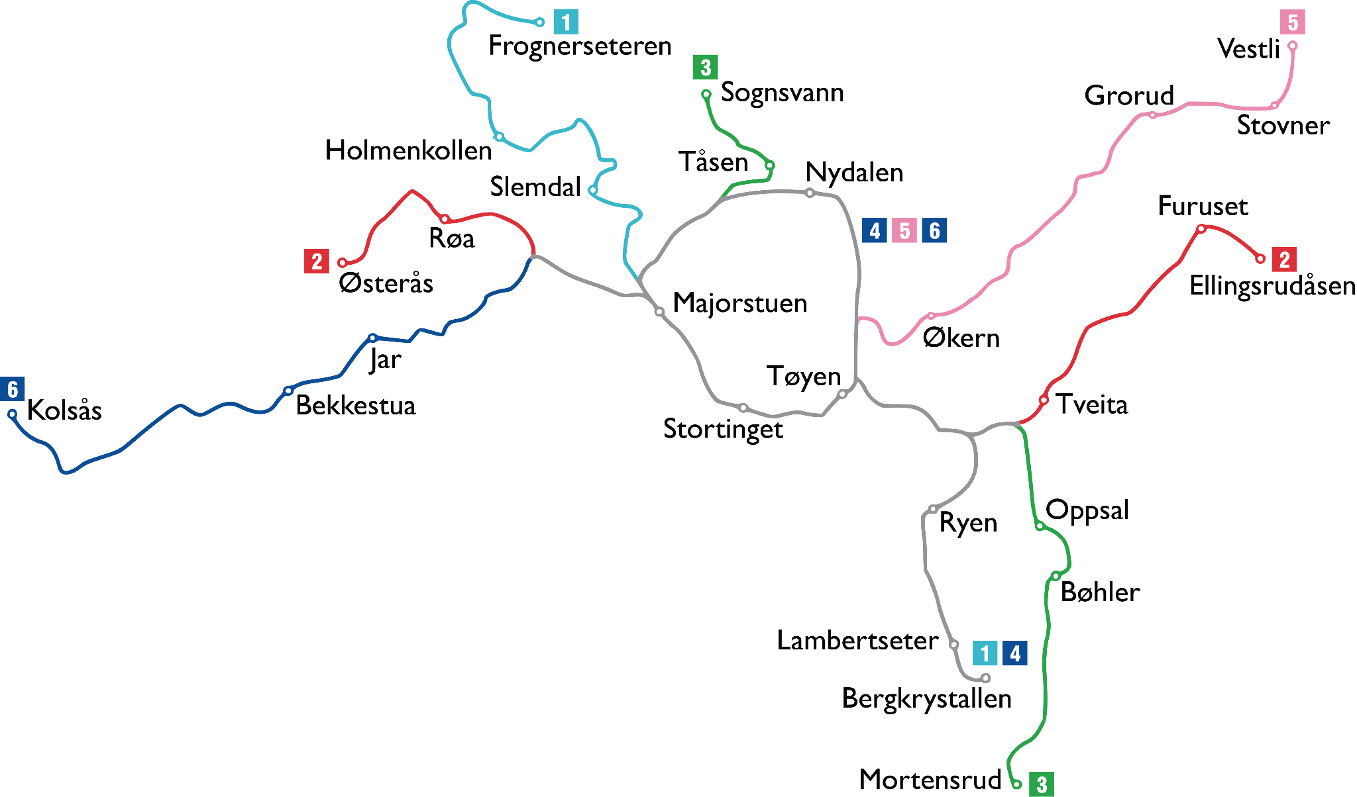
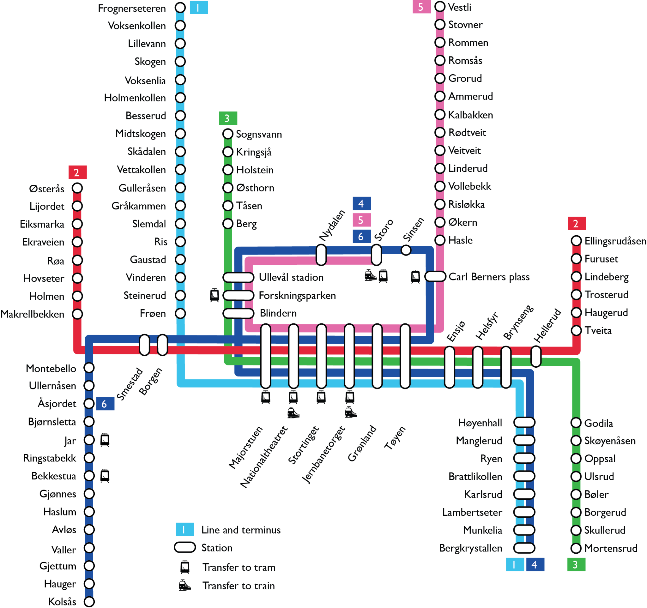
Schematic maps

Slide 25
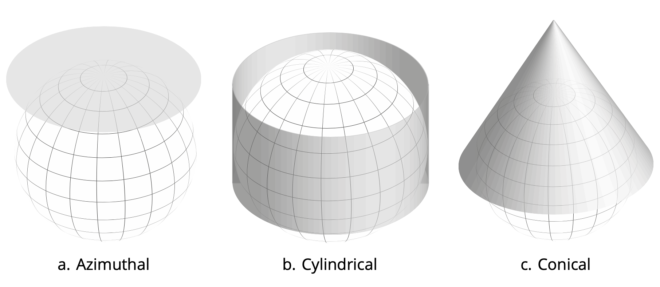
Map projections

Slide 26
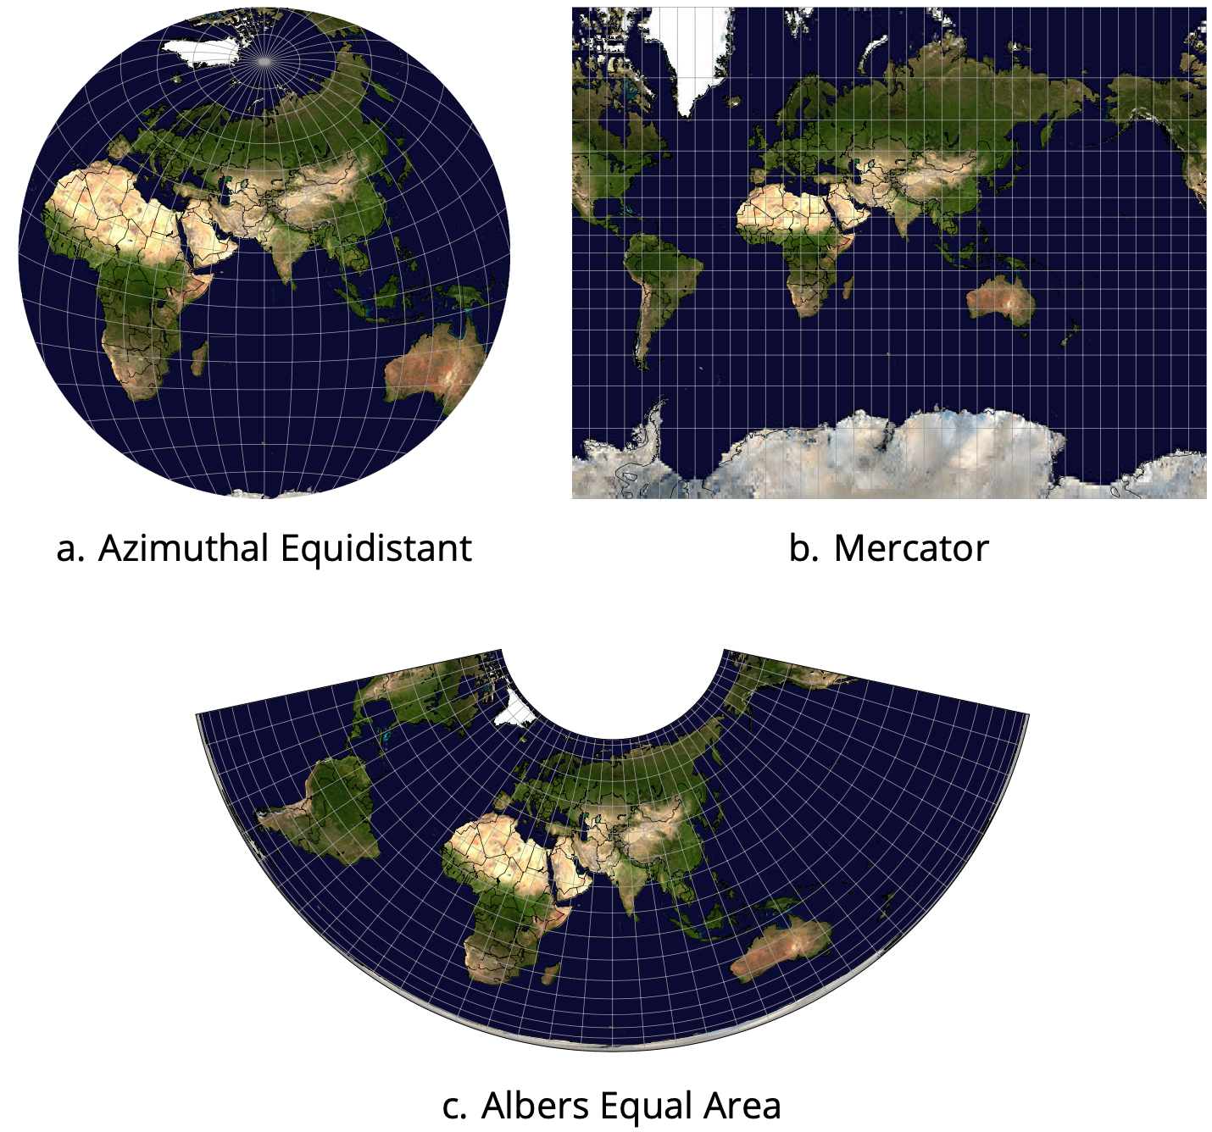
Map projections: Examples

Slide 27
Map projections
Map projections have a long history and have been topic of study and research in their own right (e.g., more than 100 distinct projections documented and implemented in NASA’s G.Projector software)
Any 2D map must necessarily be subject to a map projection.
Spatial data will either be supplied in spherical coordinates, in which case an appropriate map projection must be applied in order to display it on a 2D map; or
Spatial data will be supplied using projected coordinates, in which case the correct projection must be known and applied in order to relate that data to other data sets.
Any map projection must introduce distortion into some aspects of the projected map, whether areas, distances, or shapes and angles.

Slide 28
Map generalization
Five distinct classes of map generalization operation:
Reduction: Reducing geometric detail, e.g., the Douglas-Peucker line simplification algorithm
Merging: Merging involves combining multiple distinct geometries into a single, clearer geometry
Characterization: Characterization involves changing the shape, size, or location of geometries in order to enhance clarity
Collapse: Collapse concerns the change in dimension of a mapped geometry, from 2D area to 1D line to 0D point
Elimination: Elimination involves the removal of whole geometric features in the pursuit of clarity

Slide 29
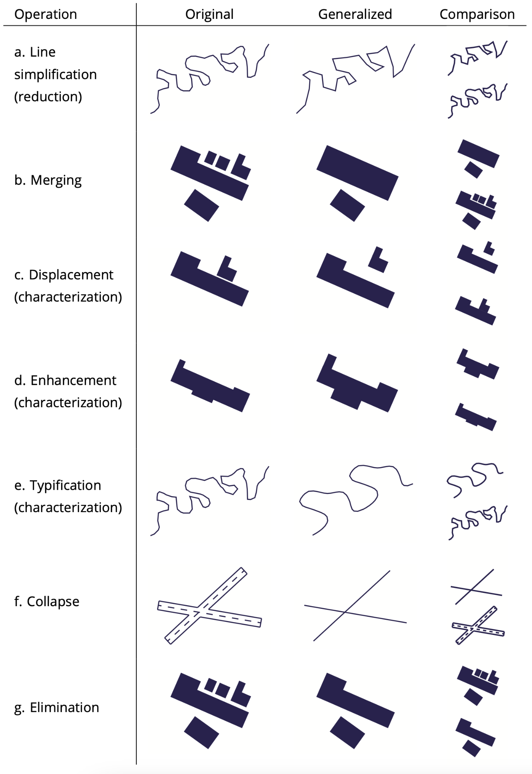
Map generalization: Reduction

Slide 30
Map generalization: Merging

Slide 31
Map generalization: Characterization

Slide 32
Map generalization: Characterization

Slide 33
Map generalization: Collapse

Slide 34
Map generalization: Elimination

Slide 35
Map labels
Point labels: point labels are preferentially positioned slightly above and to the left of the point itself.
Linear labels: linear labels typically run alongside the feature they label, preferentially conforming to the shape of the feature and avoiding backward sloping or upside-down text.
Areal labels: areal labels are typically placed inside the areal feature itself, with the type spaced so as to provide the visual impression of “filling” the area.

Slide 36
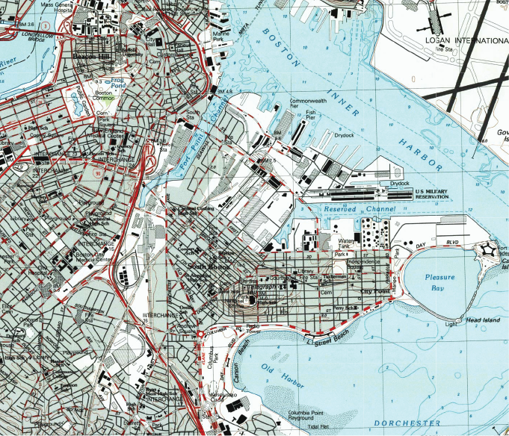
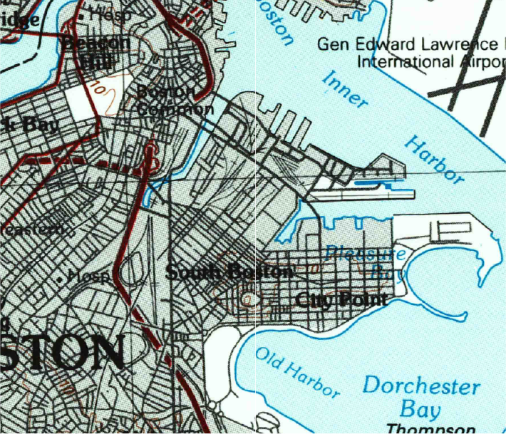
Map labels
1:25,000 map of Boston, Massachusetts (Source: U.S. Geological Survey)
1:100,000 map of Boston, Massachusetts (Source: U.S. Geological Survey)

Slide 37
Section 8.3
Interaction

Slide 38
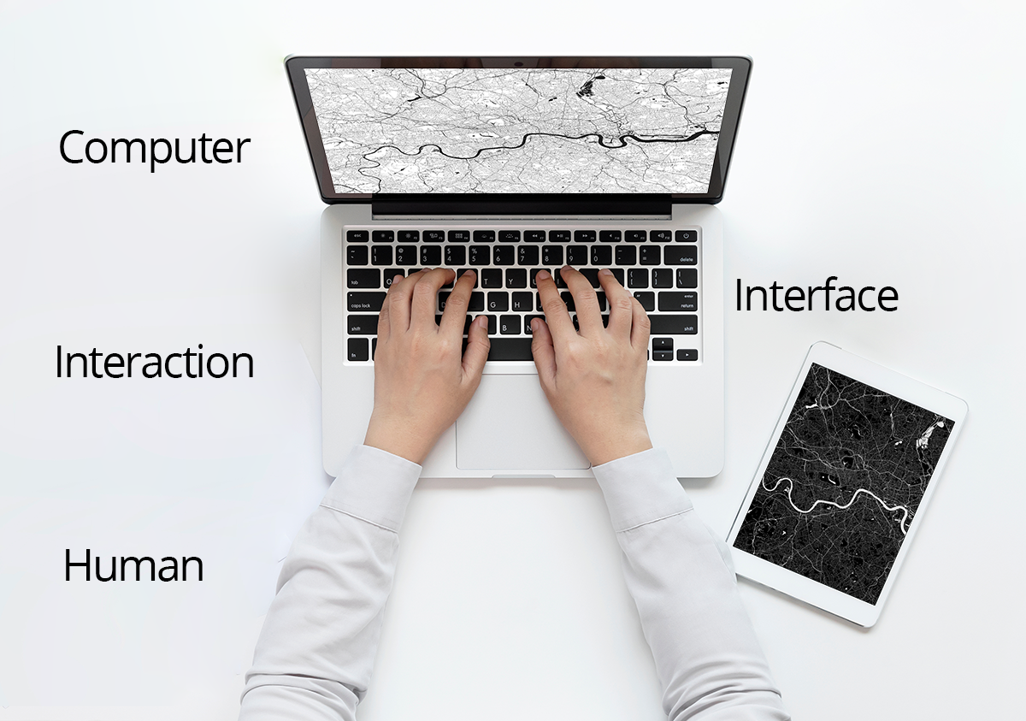
Human-computer interaction

Slide 39
Human-computer interaction
Human-computer interaction (HCI) is used to describe the interaction between computer systems and people.
The term is also used to refer to the field of HCI: the study of the design, evaluation, and implementation of the interfaces between computing devices and people.
A dialog is a process of interaction between two or more agents, whereby agents cooperate to resolve conflicts and complete some task.
The dialog between humans and computers is mediated by a user interface.

Slide 40
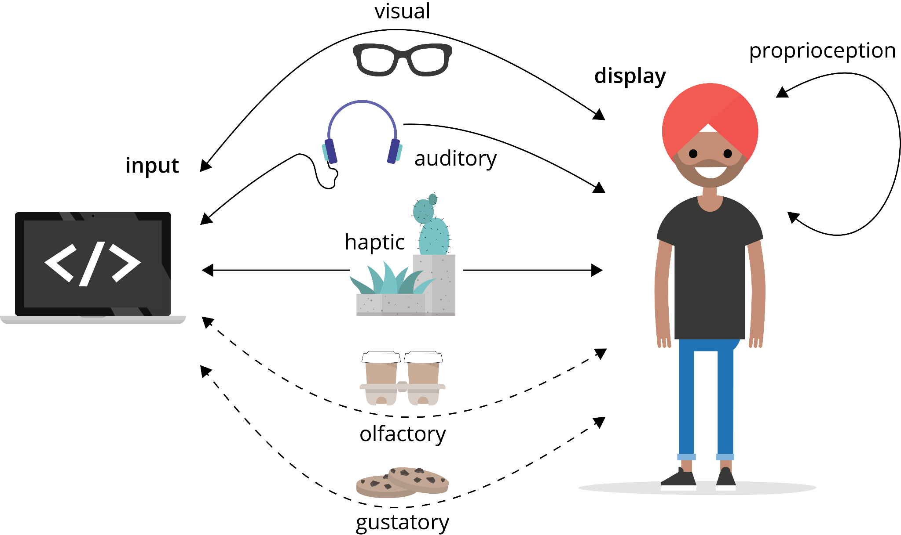
Input-output (IO) channels

Slide 41
IO
The same IO channel can often be used for sending information in both directions (from computer to human and from human to computer) at the same time
the term display is often used to refer to output from a computer to a human for any IO channel
Devices that enable display or input of information on more than one IO channel (mode) at a time are termed multimodal
Irrespective of which IO channel a device uses, it must convert information between digital and analog formats.
Humans are organisms that send and receive information in continuously varying analog formats
Computers are digital machines that require discrete digital information to operate

Slide 42
Implicit and explicit input
By default, user input is often explicit, with input entered consciously by the user via devices such as a keyboard or mouse.
By contrast, implicit input occurs where the system automatically interprets information about a user's context or actions as input.
For example, a location-aware mobile device could automatically interpret the user's location near a bus stop as an implicit query for information about the time of the next bus at that stop.

Slide 43
Intuitive and expressive interfaces
An intuitive interface is easy to use, requiring minimal effort to learn to operate.
An expressive enables users to achieve specific tasks efficiently.
The ideal interface style is both expressive and intuitive.
Unfortunately, it is not usually possible to achieve both these goals. Different interface styles must strike a balance between being expressive and intuitive.

Slide 44
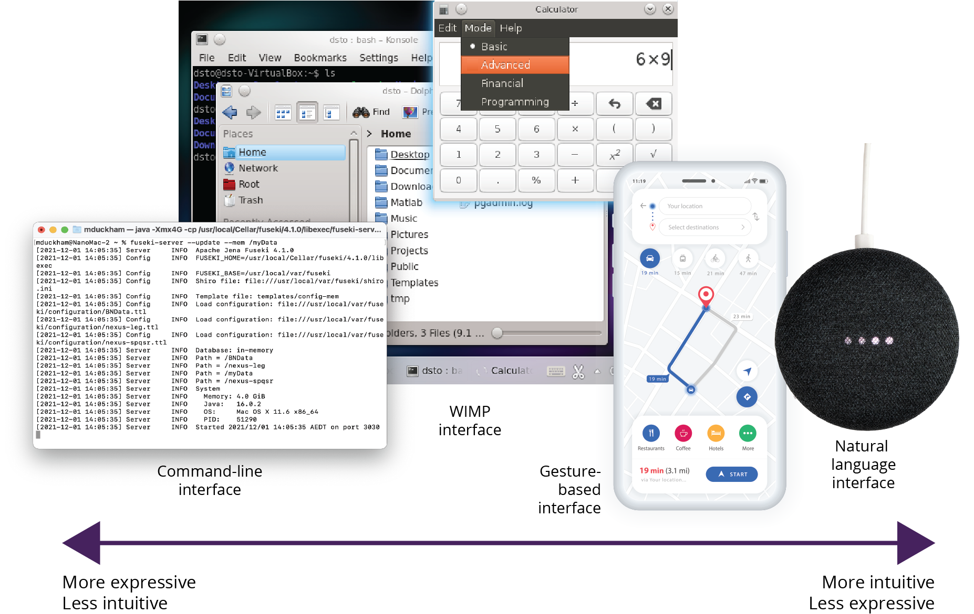
Intuitive and expressive interfaces

Slide 45
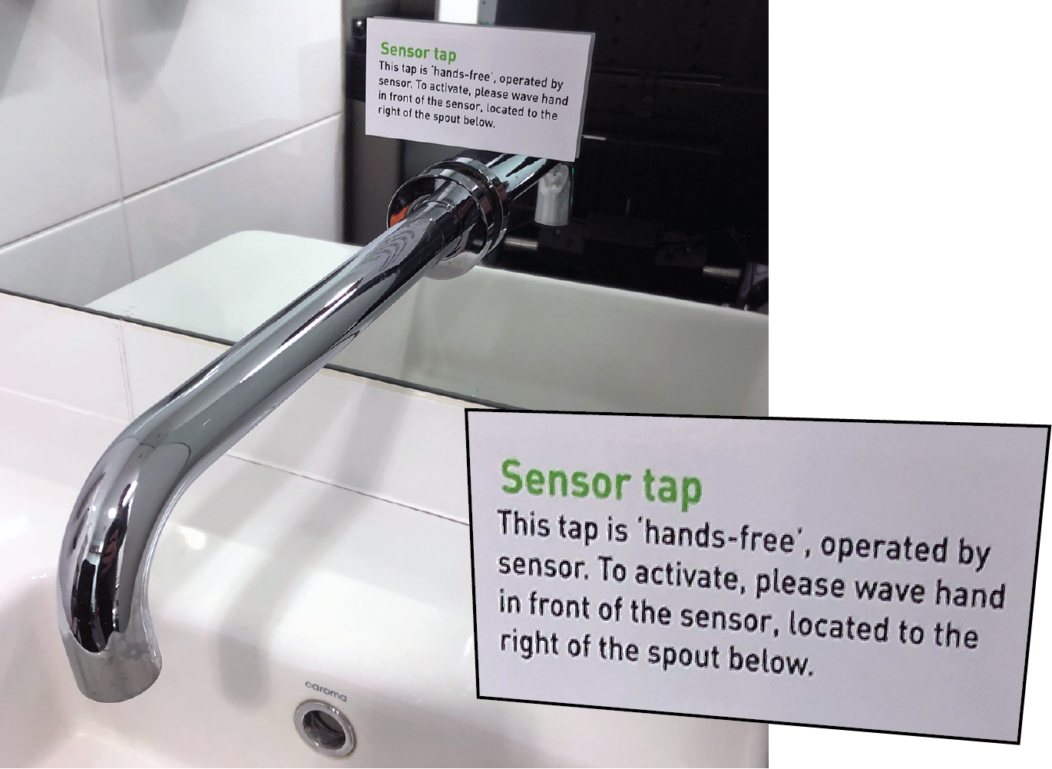
Designing intuitive interfaces
Even for the most familiar and everyday physical objects poor interface design is all too common.
Five key features of intuitive interfaces:
visibility and affordances
mappings and metaphors
simplicity
feedback
error handling

Slide 46

Visibility and affordances
Visibility is connected with ensuring that an interface makes the most important components most visible
Affordances provide the user with clues about how to operate the components

Slide 47

Mappings and metaphors
Mappings concern the relationship between interface controls and the physically or conventionally expected effects of those controls
A metaphor is the use of a word or phrase denoting one kind of idea or object in place of another, in order to make a figurative comparison between the two
For example, the desktop metaphor suggests a likeness between the computer interface and an office desktop
Many GIS interfaces use the map metaphor: they are designed to exhibit map-like characteristics, utilize map symbolization, and echo the physical characteristics of hardcopy paper maps

Slide 48
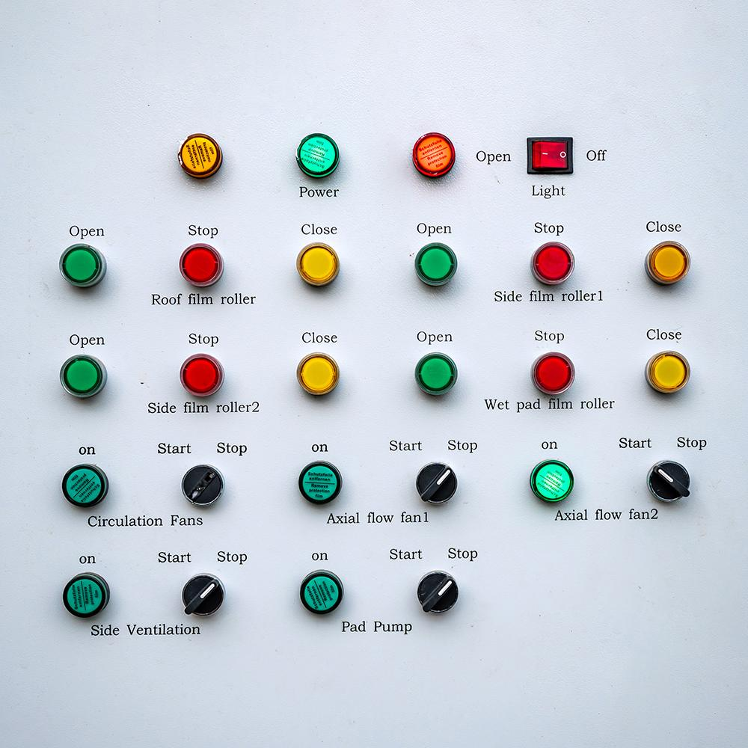
Simplicity
Intuitive interfaces are simple. Simple interfaces provide:
only those components in an interface that are strictly necessary to the functions of a system
only those functions that are strictly necessary to anticipated user needs
The term feature cascade describes the tendency to add more features to interfaces, making them more complex and unwieldy.

Slide 49

Feedback
Feedback is the process of accepting and responding to a user's actions with information about what a user has done, and what has been achieved
A response time of about 0.1 seconds or less is perceived by users as instantaneous
A response time of 1-2 seconds is still fast enough for a user's flow of thought to be uninterrupted but is a noticeable delay
A response time of 10 seconds is about the limit for feedback, as a user's attention is likely to be transferred to other tasks if delays exceed this time.

Slide 50
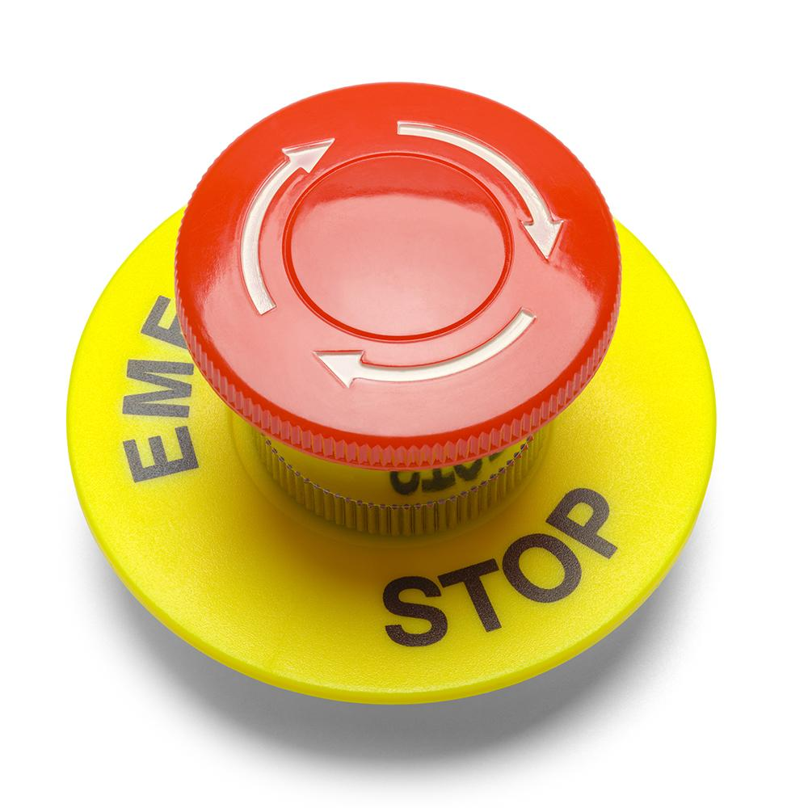
Error handling
Intuitive interfaces must allow, account for, and even anticipate mistakes by users
Forgiveness is the principle that things that are easy to do should be easy to undo
Conversely, things that are hard to undo should necessarily be harder to do in the first place
Mistakes can also be an opportunity for the user to learn about a system

Slide 51
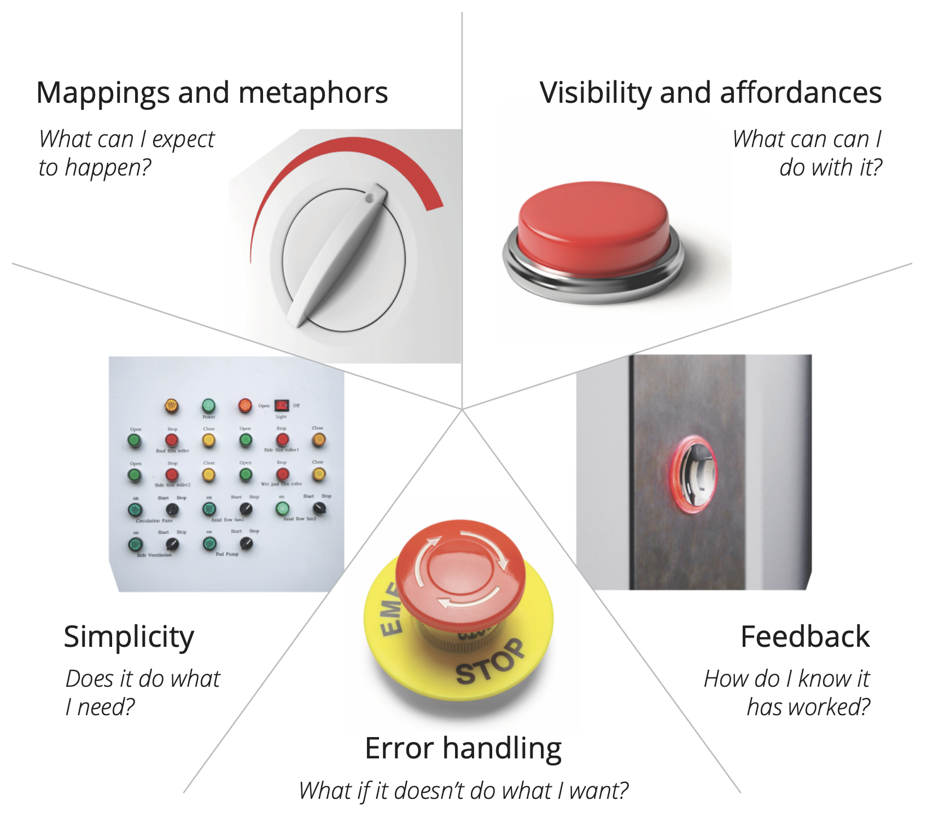
Five principles of intuitive interfaces

Slide 52
Usability engineering
The process of developing interfaces that maximize usability is termed usability engineering
Interface and interaction design is an iterative process, requiring continual cycles of prototyping, testing and critical evaluation, and redesign, for example:
FdS (five design sheet) begins with a “brainstorm” sheet, where the designer aims to develop as many possible options as possible; sheets 2-4 develop three different design options in greater detail; sheet combines, refines, and realizes a single preferred design
GOMS recursively decomposes high-level interface functionality into smaller component functionality. User goals are specified in terms of the basic operations a user can perform. Different methods for achieving a particular goal are identified. Which particular method will be selected and in which cases is the predicted
Design thinking has five stages: first, empathize with the humans whose problem you are trying to solve; second, then define a precise problem statement based on the first stage; third, ideate and look for alternative ways of approaching the problem; fourth, prototype and experiment with scaled down versions; and fifth, test the solutions out

Slide 53
Usability engineering: measuring
Five basic criteria are often used to quantify the degree of intuitiveness and expressiveness of an interface.
Time to learn: How much time does it take for users to learn how to use a system?
Speed of performance: How quickly can users carry out benchmark tasks?
Rate of errors: How many and what type of errors do users make in carrying out benchmark tasks?
Retention over time: How well do users retain their skills and knowledge over time?
Subjective satisfaction: How much did users enjoy or dislike performing benchmark tasks?

Slide 54
Section 8.4
Geovisualization

Slide 55
Geovisualization
Geovisualization or geographic visualization is the process of using computer systems to gain insight into and understanding of geospatial information
Scientific visualization is the process of using information systems to represent and interact with information in a way that enhances visual thinking
Verbal thinking is important for reading and writing, engaging in conversation, and logical thought
Visual thinking is important for reasoning about groupings, parts, and spatial configurations of objects
The ``visual'' in visualization refers to ``visual thinking,'' and not necessarily to the visual IO channel (visualization may be based on any IO channel, e.g., visual, auditory, haptic)
Geovisualization is a branch of scientific visualization that deals specifically with geospatial information
Geovisualization aims to help users gain insight into geographic problems, sometimes referred to as geographic thinking

Slide 56
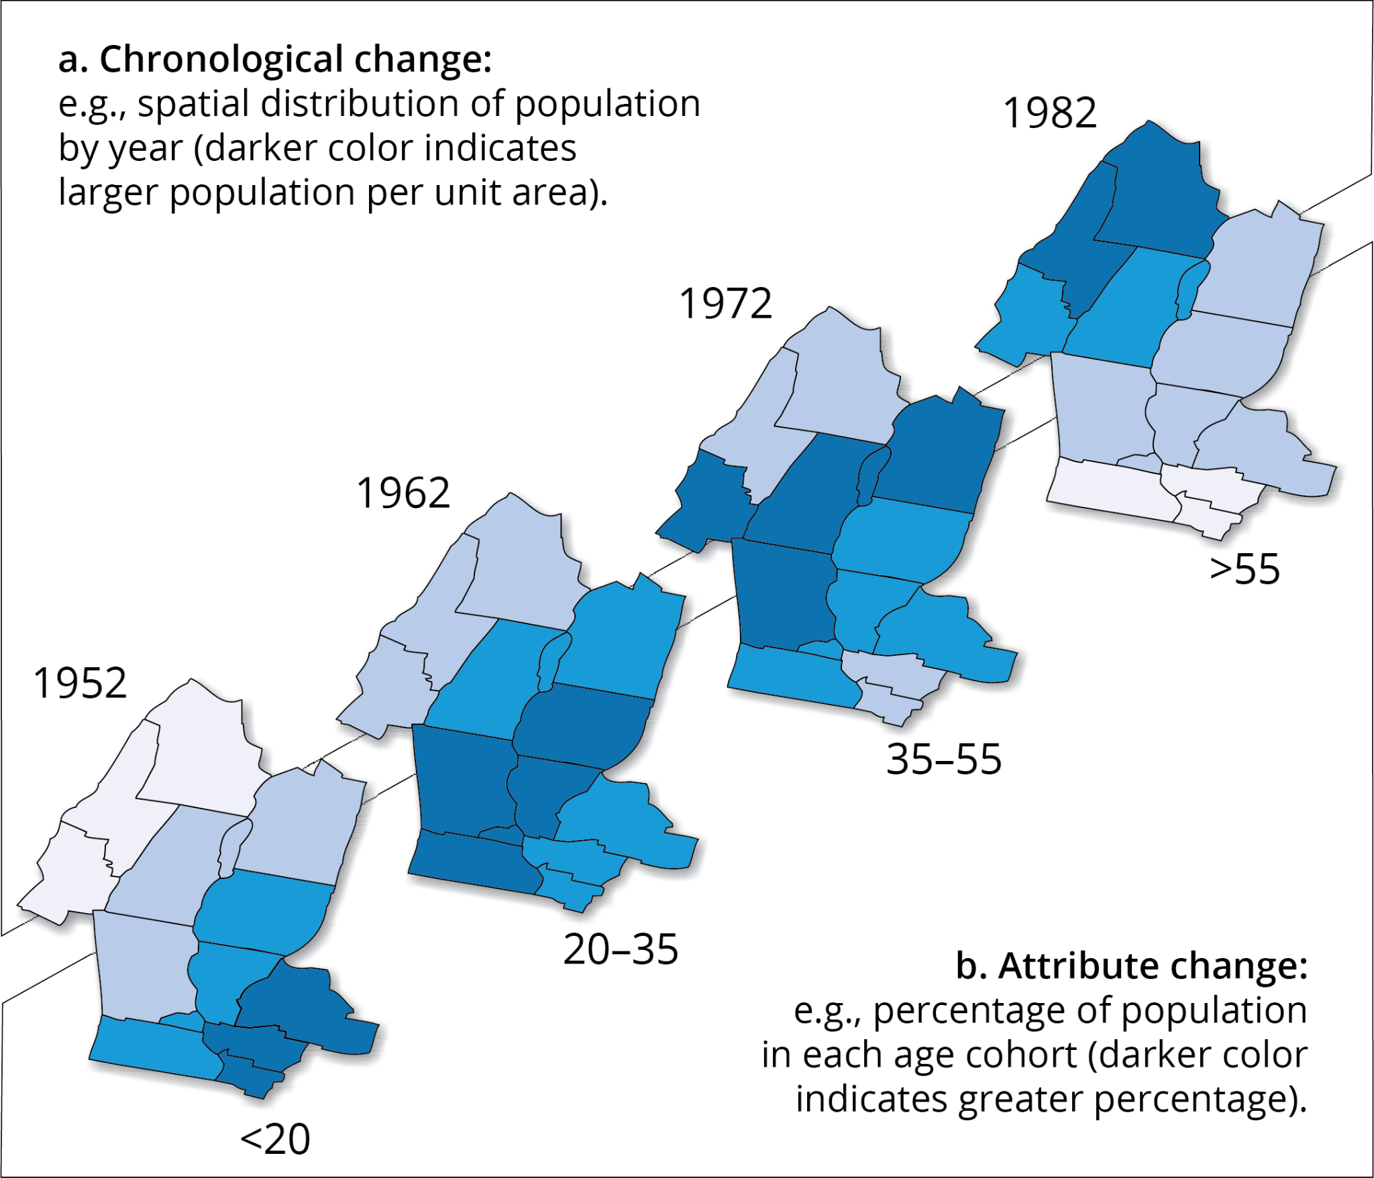
Animation
Animation aims to convey the impression of motion or change over time series of static images
Each static image within the sequence that makes up an animation is called a scene
Animation can be used for visualizing chronological change in geographic phenomena
Animations can also be constructed from any sequence of spatial or attribute changes

Slide 57
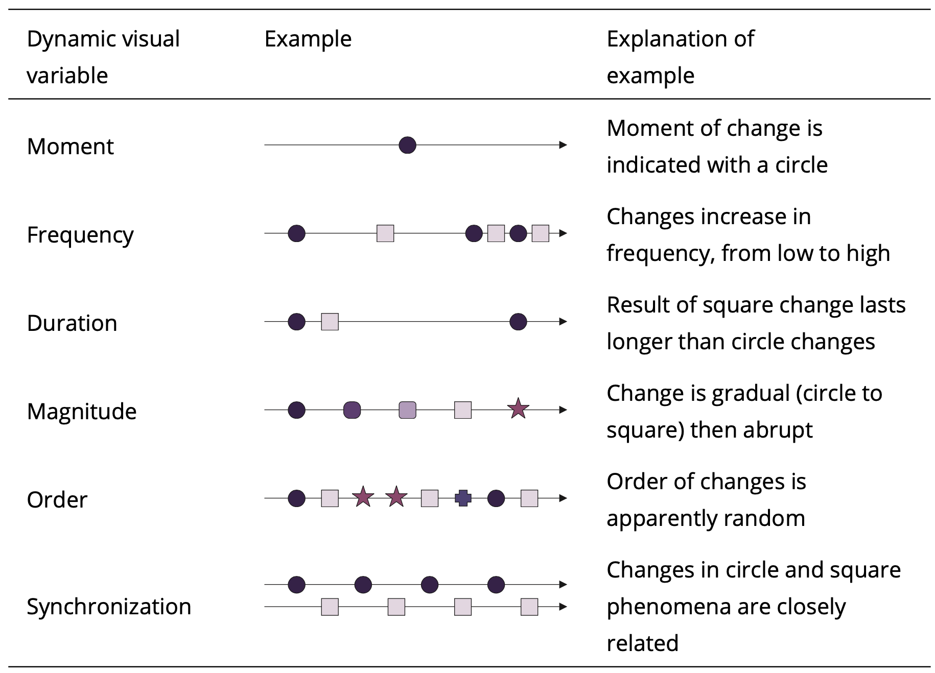
Dynamic visual variables

Slide 58
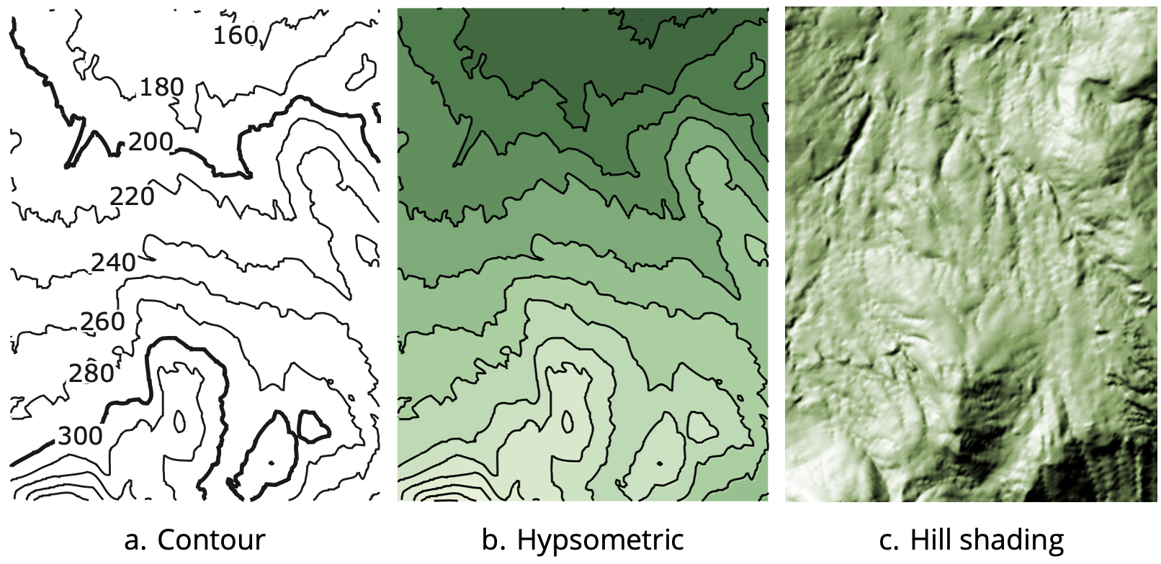
3D terrain surface representations

Slide 59
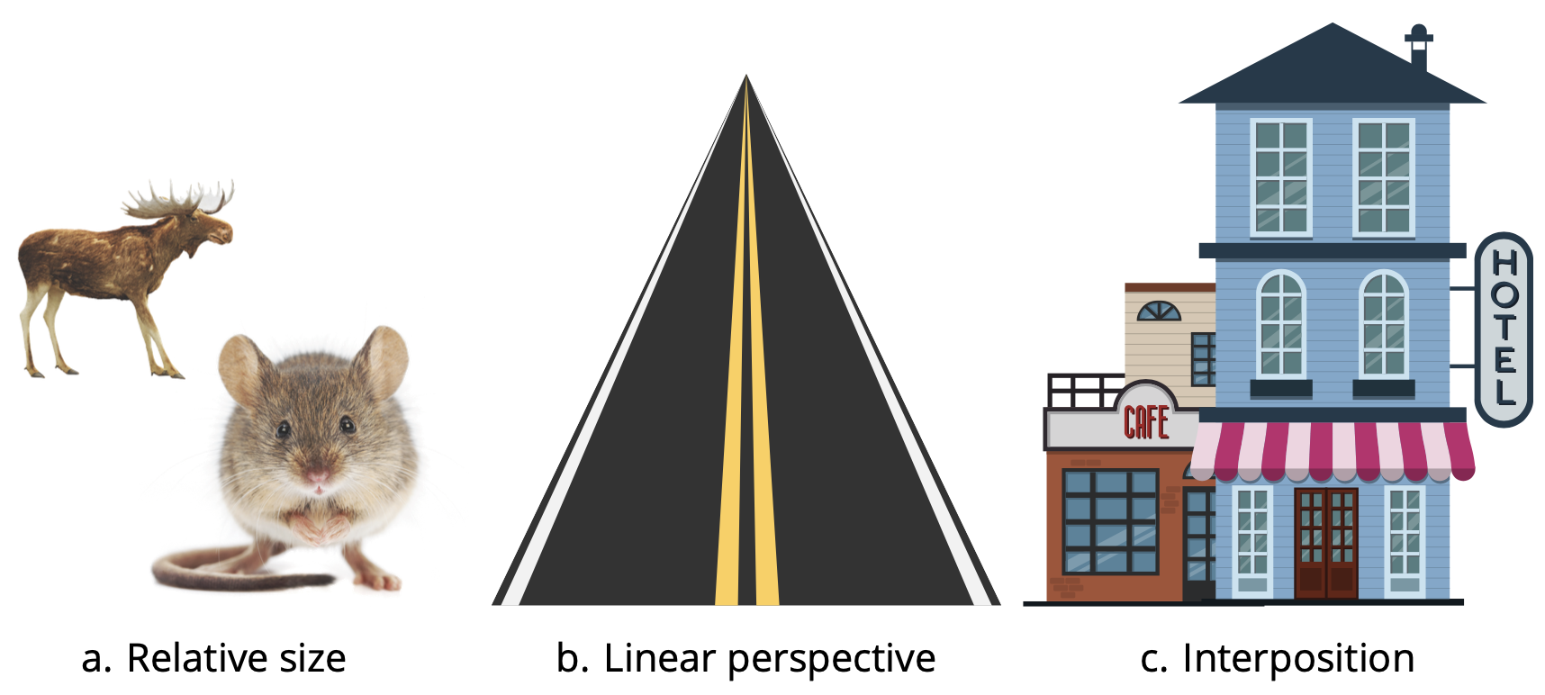
Depth cues

Slide 60
Geovisual analytics
Visual analytics is concerned with using interactive visual displays to support humans to identify and understand patterns and relationships in data
Geovisual analytics is the special case of visual analytics that deals with spatial data . The five most common basic interactions in geovisual analytics interfaces are:
Panning, zooming, navigation: Panning (change of viewpoint) and zooming (change of level of detail) are basic interactions for both spatial and non-spatial data. A high-level overview or a “home” function ensures users can avoid getting lost in data
Attribute re-expression: Attribute re-expression is the ability to interactively change the way selected data is presented in the interface
Brushing: Brushing is a form of implicit input where a user’s mouse hover is interpreted as a query for further information about any features located under the mouse pointer
Linked views: Linking multiple views involves changes to highlighted information in one view being mirrored by corresponding changes to other views
Animation: Animation can help users identify subtle patterns and interpret important changes not always visible in static views

Slide 61
Acknowledgments
Book website: http://gisacp.duckham.org All images: GIS: A Computing Perspective 3e, unless otherwise stated
Artwork: Lou Bloomer

